Slide 1
SDSS 2019 HACKATHON

Slide 2
PREDICTING POVERTY RATES IN KING COUNTY
Ben Brown, Rodney Fonseca, Monique Garrett

Slide 3
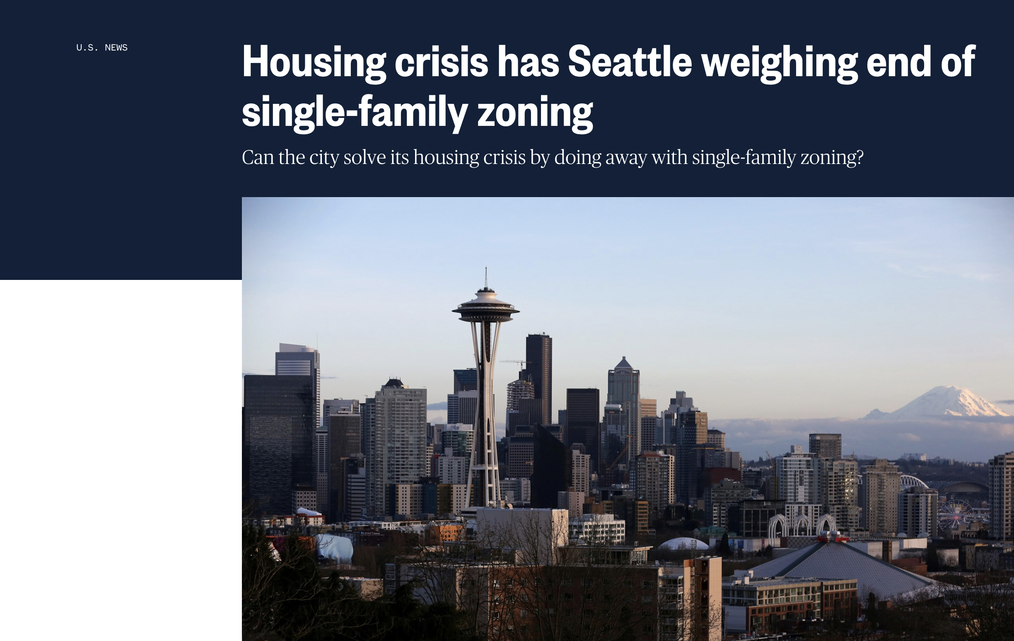
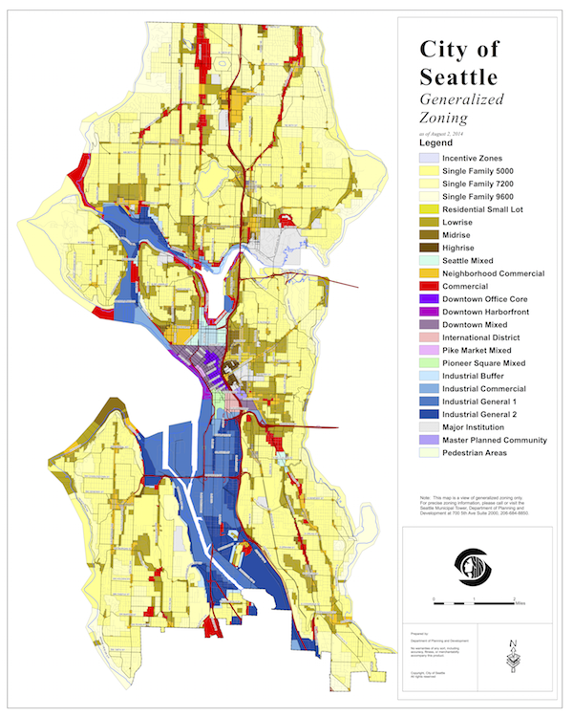

Slide 4
What if city planners could see how proposed developments would affect poverty rates of King County residents?

Slide 5
Eviction Data: Variables of Interest
GEOID
Year
Poverty rate
Renter occupied
Eviction rate
Median gross rent
Median household income
Median property value
Percentages of each ethnicity

Slide 6
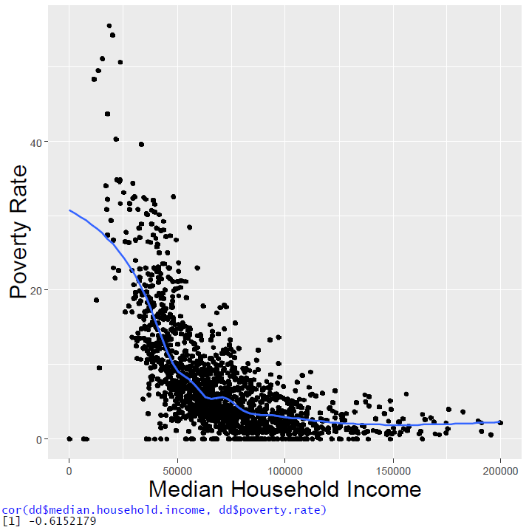
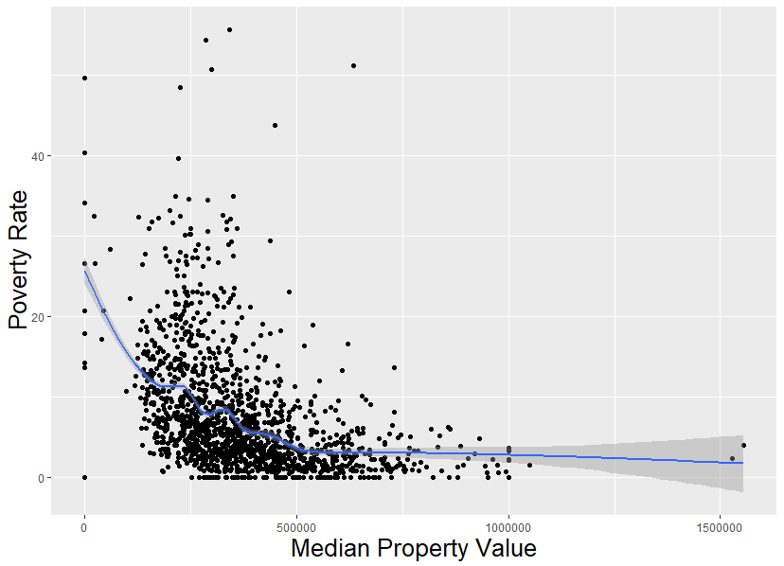
Correlation between median household income and poverty rate: -0.6152
Correlation between median property value and poverty rate: -0.4355
Notes:
We ran correlation plots between most of the variables (keeping to percent evicted over # evicted, and not low-flag, imputed, or subbed)
Included 6 of the highest correlated plots, with their respective correlations.

Slide 7
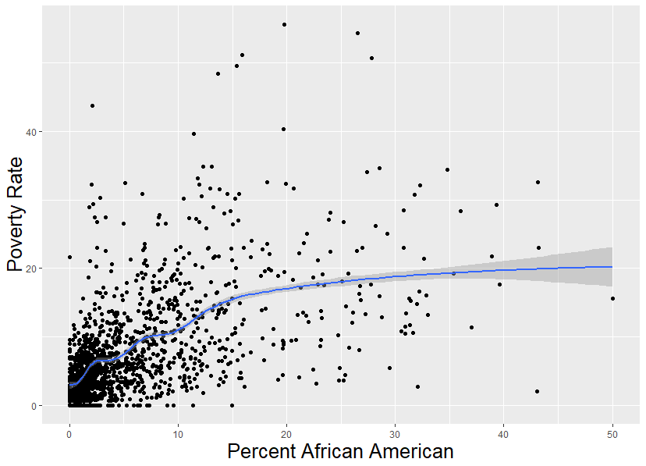
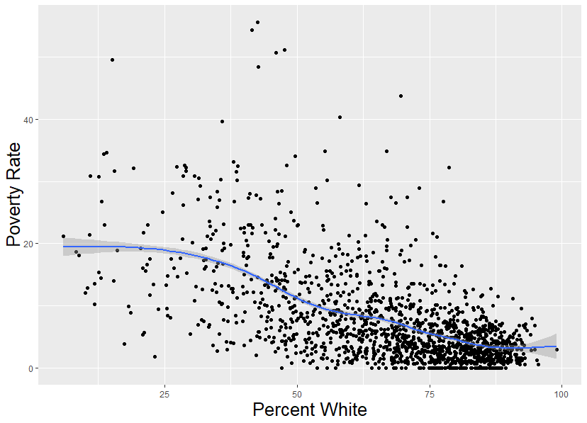
Correlation between percent african american and poverty rate: 0.5671
Correlation between percent white and poverty rate: -0.5831

Slide 8
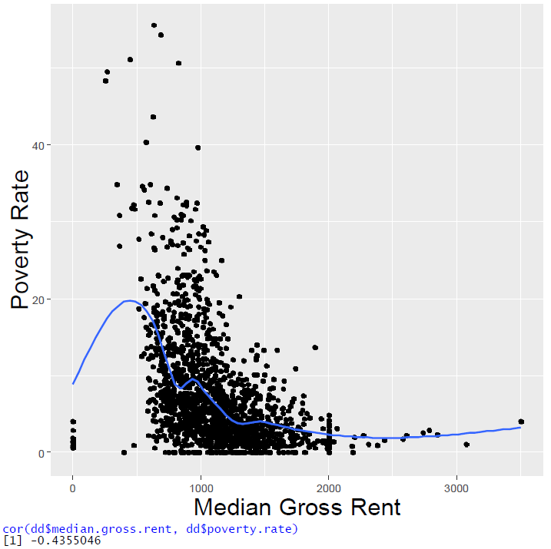
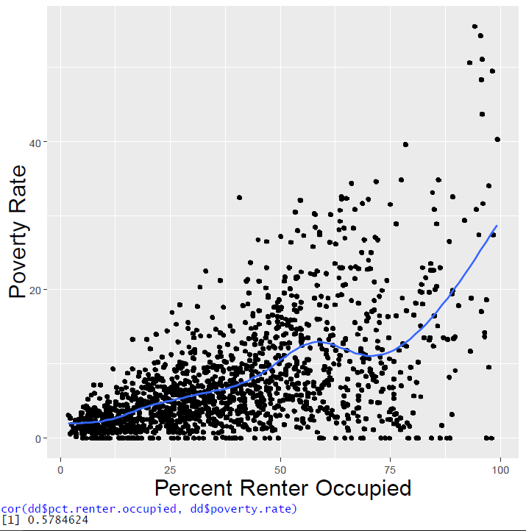
Correlation between median gross rent and poverty rate: -0.4355
Correlation between percent renter
occupied houses and poverty rate: 0.5785

Slide 9

H2O Automatic Machine Learning
h2o.automl( ) in the h2o R package
Chooses the best tuning parameters
Trains a stacked ensemble of ML models
Trains using the entire data set with cross-validation
Automatically deals with NA values and highly correlated variables

Slide 10
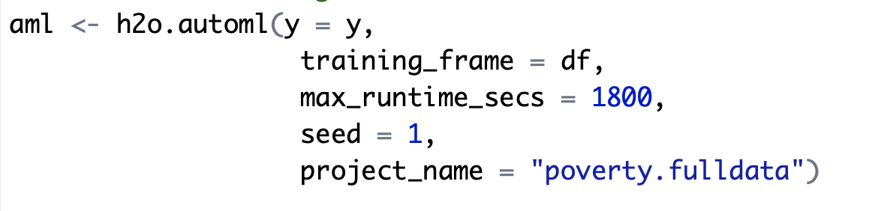
Fitting the model
Notes:
Thought it might be interesting for ppl to see the code for the model since not many ppl have heard of h2o before

Slide 11
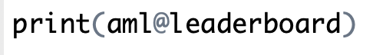
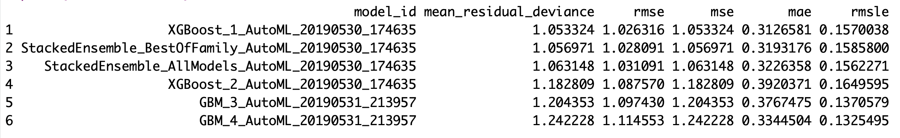
Leaderboard scores of the best models
An Extreme Gradient Boosting model is the top model
Notes:
XGBoost stands for ‘eXtreme Gradient Boosting model’.

Slide 12
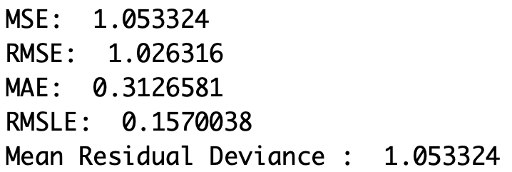
Regression metrics from XGBoost model
Using 5-fold cross validation on training data

Slide 13
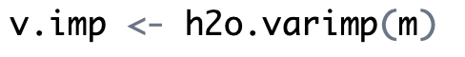
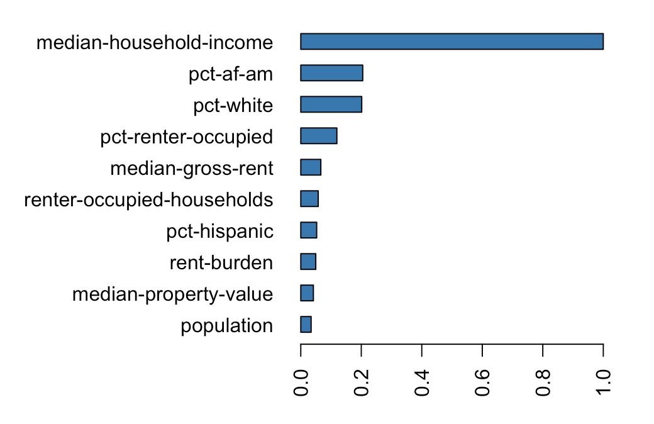
Variable importance: XGBoost

Slide 14
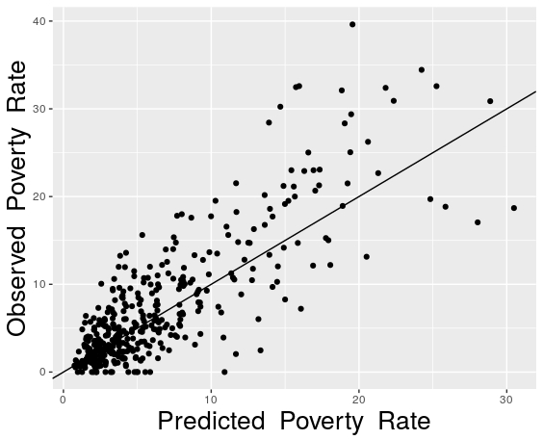
Observed vs. predicted poverty rate in 2011
Notes:
Predictions are made with the leader model, which in our case was the XGBoost

Slide 15
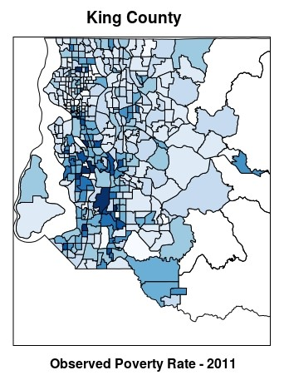
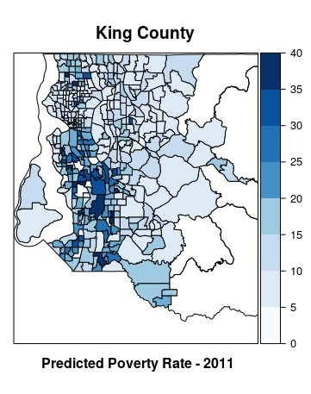
Observed vs. predicted poverty rate in 2011
Poverty Rate

Slide 16
Using the model
Single family homes to be rezoned to apartments
Estimate values of median income of future residents
Use new data to predict poverty rates
16

Slide 17

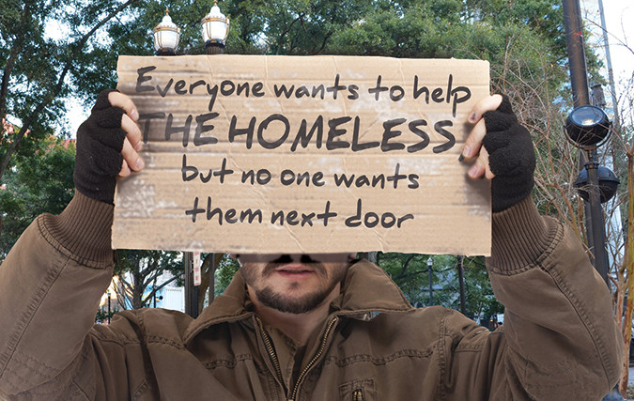
Conclusion
Show how zoning will affect poverty levels
Help people understand the effect of changing zoning laws
Make data driven decisions

Slide 18
Thank you to:
Heather Kitada Smalley
Kelly McConville
Erin Ledell from h2o.ai

Slide 19
Any questions?
moniquemg123@gmail.com
rodneyfv@gmail.com
benjaminbrown.cpe@gmail.com

